Slide 1

Experiment 5: Parking Lot Counter
Navarro, Rod Geryk C.
CPE160P - 4– A1

Slide 2
OBJECTIVES
To be able to demonstrate how a parking lot counter works.
2. To be able to apply embedded system in counting the number of cars entered and exited the parking lot.
3. To be able to demonstrate how the gate opens (if there is/are available parking slot), and closes if there are no available parking slot.
4. To be able to apply what you have learned in Microprocessor and Logic Circuits and Switching Theory.
5. To be able to apply embedded system in a simple handshaking using Arduino Kit.

Slide 3
MATERIALS
Arduino Kit
4 1k ohm Resistor
4-digit seven segment display
Ultrasonic sensor
Servo motor
2 Breadboard
Arduino Uno
Laptop

Slide 4
PROCEDURE
Create a working Parking Slot Counter circuit using Arduino.
Create a working Ultrasonic Sensor and Servo using Arduino.
To demonstrate the usage of counters and how the gate works.
Debug the code

Slide 5
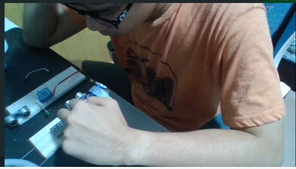
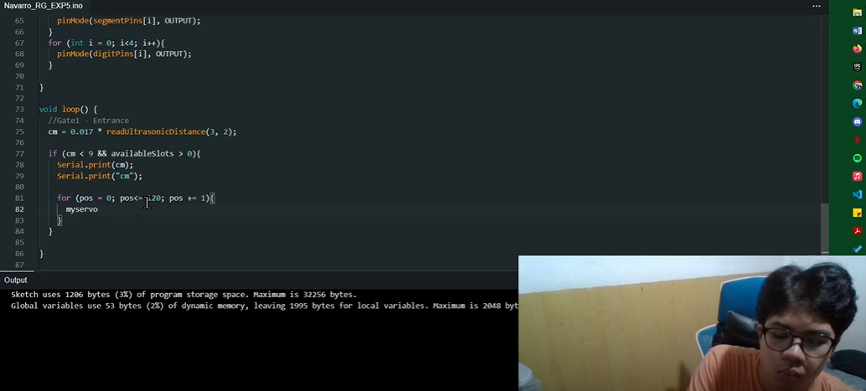
PROCEDURE

Slide 6
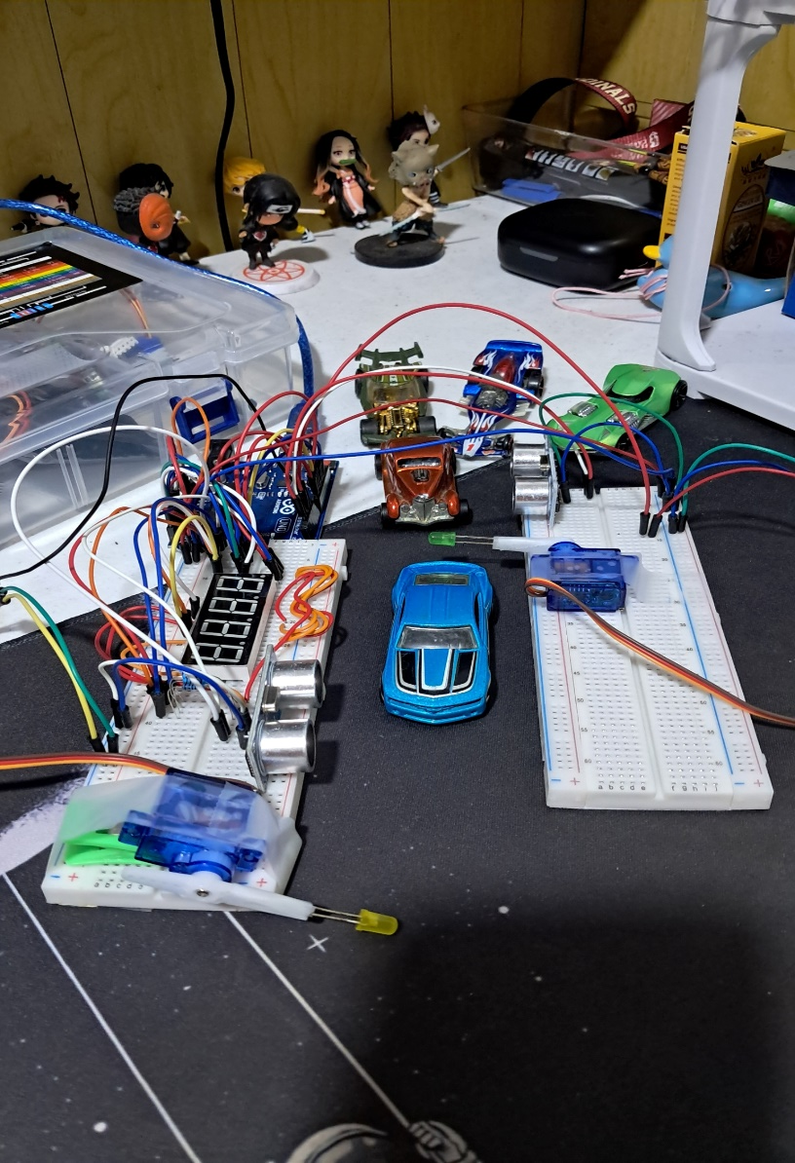
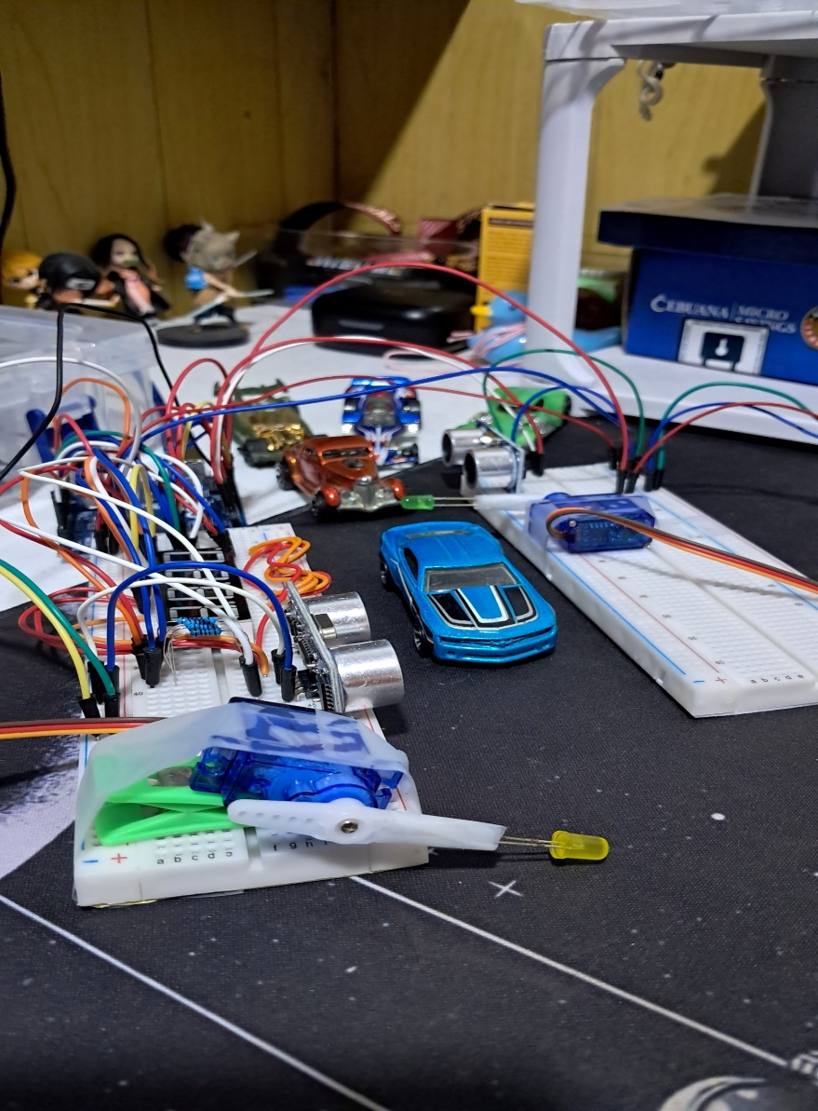
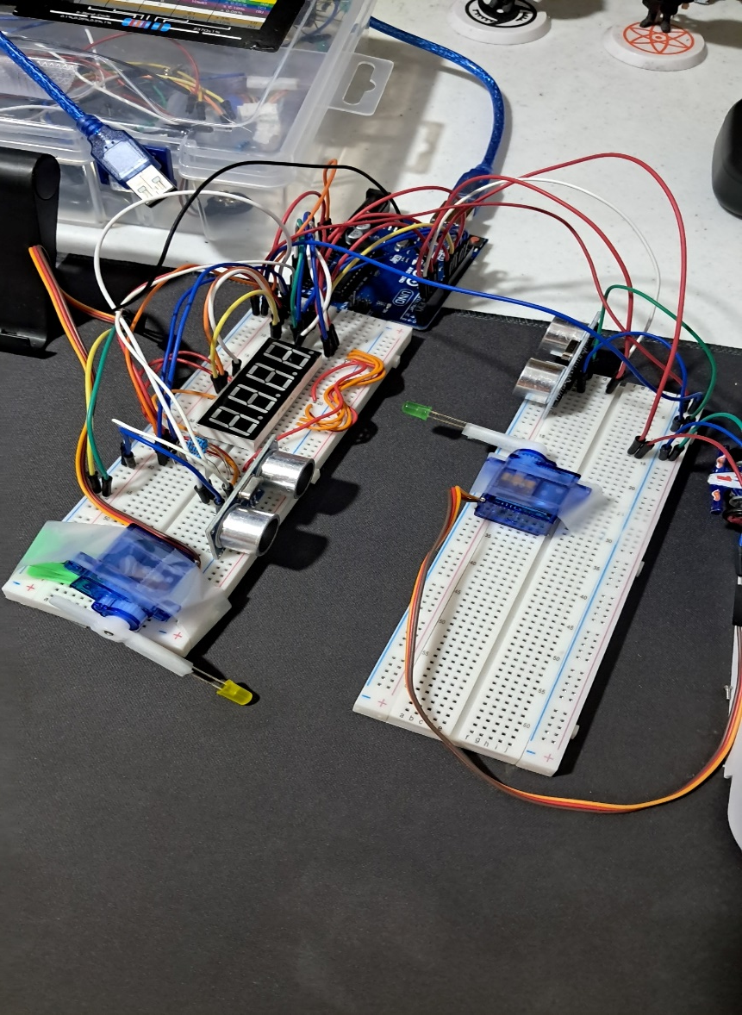
Final Output

Slide 7
THANK YOU!

